Slide 1
Will I Have A Stroke?
By Jose Daniel Arechiga

Slide 2
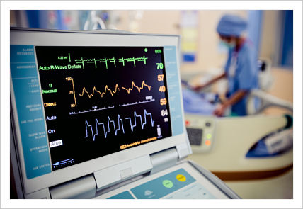
The Dataset
The dataset, “Stroke Prediction Dataset” was derived from Kaggle
The data includes features such as gender, age, various diseases, various health metrics, and smoking status
Predictions produced will be based on these features from the data

Slide 3
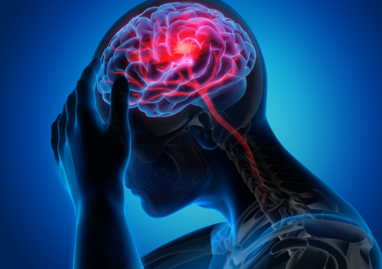
2nd Leading Cause of Death
According to the World Health Organization (WHO) strokes are the 2nd leading cause of death globally (approximately 11% of total deaths)
The purpose of predicting strokes is to be proactive in combatting strokes before any at-risk patients can suffer a stroke

Slide 4
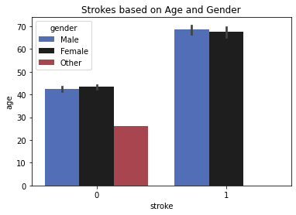
Forever Young
The two features we are looking at here are gender and age, and how they can be related to having a stroke.
Strokes don’t seem to vary much among genders, with males and females showing comparable levels when having a stroke(1) or not(0).
Age however, seems to be a big factor. Many of those who have had a stroke seem to be approaching 70 years old.

Slide 5
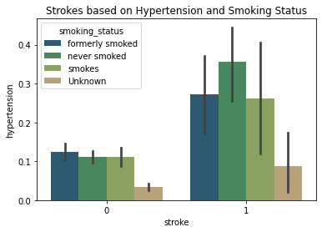
Puff Puff Pass and Relax
A couple other features of note are hypertension and smoking status.
According to the data, patients with elevated levels of hypertension were those who suffered from strokes.
Interestingly enough, those who have never smoked had the highest levels of hypertension.
While smoking is a risk factor for many health issues, it doesn’t seem to a big factor when it comes to strokes.

Slide 6
Machine Learning Models
Stroke Prediction: Classification
Models used:
Logistic Regression, KNN Classifier
The Logistic Regression model performed the best
The logistic regression model was able to predict strokes 75% of the time
The Logistic Regression model is the production model I choose

Slide 7
About Logistic Regression
Logistic Regression is a machine learning model designed to be used on classification problems such as this one.
Additionally, Logistic Regression is simple to implement and it makes it easier to be able to interpret how the model makes its predictions.
One of the caveats to using Logistic Regression, however, is that the data must be processed and scaled for the model to work.

Slide 8
Recommendations
The model can predict a person will have a stroke 75% of the time. This means 75% more people will be identified as at risk for having a stroke. I recommend using these predictions to help people at risk by making them aware of where their health stands and begin to take preventative measures so that they can put themselves in a better position to avoid having a stroke.

